Slide 1
OO Design Principles & Techniques
Units
  Design Fundamentals
  Object Collaborations & Design Techniques
  Design Principles
Module: OO Design Principles & Techniques
Copyright © Venkat Shiva Reddy – Trainer, Aug 2005

Slide 2

Unit 1
Design Fundamentals
Module: OO Design Principles & Techniques
Copyright © Venkat Shiva Reddy – Trainer, Aug 2005

Slide 3
Design Fundamentals
Topics
  A quick introduction to UML class diagrams
  Relationships
    Generalization
    Realization
    Association
    Aggregation
    Composition
    Dependency
  Remodeling Private Inheritance
  Problems with Multiple Inheritance
  Applying OO Design Techniques – a case study
  Understanding the ‘Has-a’ relationship
Module: OO Design Principles & Techniques
Copyright © Venkat Shiva Reddy – Trainer, Aug 2005

Slide 4






Class Diagram
Every class has three compartments
  Name of the class
  Structure (Data members)
  Behavior (Methods)
Employee
empId : String
name : String
Structure
address : Address
getEmpID() : String
setEmpId(empId : String)
Behavior
getName() : String
setName(name : String)
getAddress() : Address
setAddress(address : Address)
Module: OO Design Principles & Techniques
Copyright © Venkat Shiva Reddy – Trainer, Aug 2005

Slide 5
Class Diagram
Other representations
Employee
empId : String
name : String
Employee
address : Address
empId : String
Employee
name : String
getEmpID() : String
address : Address
setEmpId()
getName() : String
setName()
getAddress() : Address
setAddress()
Module: OO Design Principles & Techniques
Copyright © Venkat Shiva Reddy – Trainer, Aug 2005

Slide 6


Interface
Is an extension of the class symbol in UML
Standard UML offers no different symbol for interface
  Instead a stereotype is used to extend the class symbol to represent an interface
Ideally an interface should have only abstract behavior (key abstractions) and no structure
UML Representation
Rational Rose representation
<<Interface>>
IAccount
IAccount
withdraw()
deposit()
withdraw()
deposit()
open()
open()
close()
close()
Module: OO Design Principles & Techniques
Copyright © Venkat Shiva Reddy – Trainer, Aug 2005

Slide 7
Relationships
UML supports representing six types of relationships
  Generalization
  Realization
  Association
  Aggregation
  Composite Aggregation (Composition)
  Dependency
Module: OO Design Principles & Techniques
Copyright © Venkat Shiva Reddy – Trainer, Aug 2005

Slide 8
Relationships
Classification
  <<Is-a>>
  Generalization
  Realization
  <<Has-a>>
  Association
  Aggregation
  Composition
  <<Uses>>
  Dependency
Module: OO Design Principles & Techniques
Copyright © Venkat Shiva Reddy – Trainer, Aug 2005

Slide 9
Relationship Meta Model
UMLClassRelationships
Structural
Behavioral
is-a
has-a
uses
Association
Generalization
Realization
Dependency
Aggregation
Composition
Module: OO Design Principles & Techniques
Copyright © Venkat Shiva Reddy – Trainer, Aug 2005

Slide 10
Remodeling Private Inheritance
Consider the following case
        B needs to provide some implementations for its methods exposed to the clients. The developer of class B discovers that some implementation is readily available in class A and hence can be reused. The problem however is that the reuse of implementation should be transparent to the clients. The implementations used by B from A cannot be exposed on the class B. It needs to keep the implementations localized to the class B only.
        Private Inheritance is a good candidate to solve this problem in C++
How would you re-model this in C# ?
A
<<private>>
B
Module: OO Design Principles & Techniques
Copyright © Venkat Shiva Reddy – Trainer, Aug 2005

Slide 11
Remodeling Private Inheritance
Solution:
B
A
Using ‘has-a’ addresses the needs maintainability
B
A
B can now reuse not only A’s implementation in private, but also that of A1 and A2
A1
A2
Module: OO Design Principles & Techniques
Copyright © Venkat Shiva Reddy – Trainer, Aug 2005

Slide 12
Remodeling Private Inheritance
Design the solution to the problem
Understand the reasons why C# or Java does not allow private inheritance
This solution is more maintainable than private inheritance
Understand that reuse need not be achieved only through Inheritance
Module: OO Design Principles & Techniques
Copyright © Venkat Shiva Reddy – Trainer, Aug 2005

Slide 13
Interface
<<Interface>>
Interfaces define a protocol of behavior that can be implemented by any class anywhere in the class hierarchy
A class that implements the interface agrees to implement all the methods defined in the interface, thereby agreeing to certain behavior
Serves as a contract between the provider and the user
Helps in integration
Facilitates parallel development
Try to provide access to set of classes outside a package or in another layer via an interface
Module: OO Design Principles & Techniques
Copyright © Venkat Shiva Reddy – Trainer, Aug 2005

Slide 14
Interface versus Abstract Class
An interface cannot implement any methods, whereas an abstract class can
A class can implement many interfaces but can have only one super class.
An interface is not part of the class hierarchy. Unrelated classes can implement the same interface.
Beware, interfaces should not grow
  Impacts all the implementing classes
Design an interface up-front before deciding the implementations
Module: OO Design Principles & Techniques
Copyright © Venkat Shiva Reddy – Trainer, Aug 2005

Slide 15
Problems with Multiple Inheritance (MI)
The two types of Inheritance in a OO language are
  Implementation Inheritance (Generalization)
  Interface Inheritance (Realization)
Eliminate Multiple Inheritance (MI) between classes
Possible to have multiple inheritance between interfaces
Possible for a class to realize multiple interfaces
Multiple Implementation Inheritance is a problem
Multiple Interface Inheritance is possible
Module: OO Design Principles & Techniques
Copyright © Venkat Shiva Reddy – Trainer, Aug 2005

Slide 16
Why is MI bad?
Redundancy in implementation reuse
Replication of state
Ambiguity in invoking methods of the Base classes
Virtual Base classes have overheads of ‘Virtual ness’
Simply put, Not maintainable
Hence a good design,
  allows multiple
    Interface Inheritance
  disallows multiple
    Implementation Inheritance
Module: OO Design Principles & Techniques
Copyright © Venkat Shiva Reddy – Trainer, Aug 2005

Slide 17
Multiple Inheritance (MI)
Consider the following scenario
Engine
PetrolEngine
DieselEngine
How would you create a HybridEngine, which needs to reuse the implementations of both Petrol Engine and Diesel Engine?
Module: OO Design Principles & Techniques
Copyright © Venkat Shiva Reddy – Trainer, Aug 2005

Slide 18
Multiple Inheritance (MI)
Solution 1
Solution 2
GenericParser
GenericParser
DOMParser
SAXParser
DOMParser
SAXParser
HybridParser
HybridParser
Module: OO Design Principles & Techniques
Copyright © Venkat Shiva Reddy – Trainer, Aug 2005

Slide 19
Understanding the ‘Has-a’ relationship
Ideally ‘has-a’ can be represented as
  Association
  Aggregation
  Composition
For the purpose of simplicity, we will represent ‘has-a’ as aggregation
Inheritance Vs Aggregation
  Should be interpreted as ‘is-a’ Vs ‘has-a’ in our subsequent discussions to understand the ‘has-a’ relationship
Module: OO Design Principles & Techniques
Copyright © Venkat Shiva Reddy – Trainer, Aug 2005

Slide 20
Problem 1
A
B
Consider the above diagram
  Name different ways of storing an instance of B in an instance of A
Module: OO Design Principles & Techniques
Copyright © Venkat Shiva Reddy – Trainer, Aug 2005

Slide 21
Problem 2
A
B
A1
A2
B1
Consider the above diagram. Which among the following statements are true?
  1. ‘A’ can use the implementation of B
  2. ‘A’ can use the implementation of B1
  3. ‘A1’ can use the implementation of B
  4. ‘A’ can behave like B
  5. ‘A2’ cannot behave like B
  6. Objects of ‘A’, ‘A1’, ‘A2’, ‘B1’ can be passed to a method which receives a reference to B
Module: OO Design Principles & Techniques
Copyright © Venkat Shiva Reddy – Trainer, Aug 2005

Slide 22
Problem 3
A
B
A1
A2
B1
Consider the above diagram. Which among the following statements are true?
1. ‘A’ can use the implementation of B
  2. ‘A’ can use the implementation of B1
  3. ‘A1’ can use the implementation of B
  4. ‘A2’ can use the implementation of B1
  5. ‘A’ can behave like B
  6. Objects of ‘A’, ‘A1’, ‘A2’ can be passed to a method which receives a reference to B
Module: OO Design Principles & Techniques
Copyright © Venkat Shiva Reddy – Trainer, Aug 2005

Slide 23
Problem 4
A
B
A1
Consider the above diagram
  Name different ways of storing an instance of B in an instance of A1
Module: OO Design Principles & Techniques
Copyright © Venkat Shiva Reddy – Trainer, Aug 2005

Slide 24
Problem 5
A
B
C
A1
B1
C1
C2
Consider the above diagram. Given that
  A has B
  A1 has B
  A1 has B1
  B1 has C1
  B1 has C2
  B cannot have C
  B1 cannot have C
Refine the above diagram to achieve the same. Keep in mind maintainability when C3, C4, etc. may need to be accommodated in B1.
Module: OO Design Principles & Techniques
Copyright © Venkat Shiva Reddy – Trainer, Aug 2005

Slide 25
Problem 5: Solution
C
A
B
<<abstract>>
AbsC
A1
B1
C1
C2
Module: OO Design Principles & Techniques
Copyright © Venkat Shiva Reddy – Trainer, Aug 2005

Slide 26

Question time
Please try to limit the questions to the topics discussed during the session.
Participants are encouraged to discuss other issues during the breaks.
Thank you.
Module: OO Design Principles & Techniques
Copyright © Venkat Shiva Reddy – Trainer, Aug 2005

Slide 27
Unit 2
Object Collaborations & Design Techniques
Module: OO Design Principles & Techniques
Copyright © Venkat Shiva Reddy – Trainer, Aug 2005

Slide 28
Object Collaborations & Design Techniques
Topics
  What is collaboration
  Types of Collaboration
    Auto
    Base-Derived
    Sibling
    Peer to peer
  Collaboration & Relationships
  Why prefer Aggregation over Inheritance
Module: OO Design Principles & Techniques
Copyright © Venkat Shiva Reddy – Trainer, Aug 2005

Slide 29
Object Collaborations
‘The objects within a program must collaborate; otherwise, the program would consist of only one big object that does everything.’
Module: OO Design Principles & Techniques
Copyright © Venkat Shiva Reddy – Trainer, Aug 2005

Slide 30
Collaboration
A collaboration occurs every time two or more objects interact
A relationship between the two objects is hence established
High Cohesion and low coupling desired
client : Client
a:A
b:B
f1()
x()
Module: OO Design Principles & Techniques
Copyright © Venkat Shiva Reddy – Trainer, Aug 2005

Slide 31
Object Collaborations
What are the different ways through which the method ‘x’ can be invoked from within the class ‘A’ ?
Is it possible to model a collaboration through any relationship – is-a, has-a or uses?
2: x()
a:A
b:B
Module: OO Design Principles & Techniques
Copyright © Venkat Shiva Reddy – Trainer, Aug 2005

Slide 32
Collaboration types
Auto collaboration
  A message to self
Base-derived collaboration
Sibling collaboration
  Derived classes of the same class hierarchy collaborate
Peer to peer collaboration
  Two unrelated objects collaborate
Module: OO Design Principles & Techniques
Copyright © Venkat Shiva Reddy – Trainer, Aug 2005

Slide 33
Auto Collaboration
A message to self
Auto Collaboration is a good pointer to private methods
2: x()
client
a:A
f1()
1: f1()
x()
client
a:A
class A {
public void f1() {
this.x();
}
private void x() { }
}
Module: OO Design Principles & Techniques
Copyright © Venkat Shiva Reddy – Trainer, Aug 2005

Slide 34
Auto Collaboration
Where will you capture the message passed from object a1 to ‘obj’?
client : Client
a1 : A
obj : A
f1()
x()
Module: OO Design Principles & Techniques
Copyright © Venkat Shiva Reddy – Trainer, Aug 2005

Slide 35
Auto Collaboration: Example
class Catalogue
{
private Book[MAX] books;
private Book GetBookByTitle(string title)
{
Book book;
for(int i=0;i<numOBooks;i++)
// find the book
return book;
}
public void ViewBookByTitle(string title)
{
Book book = GetBookByTitle(title);
book.ShowBookDetails();
}
}
Catalogue
getBookByTitle
<< Collaboration >>
Module: OO Design Principles & Techniques
Copyright © Venkat Shiva Reddy – Trainer, Aug 2005

Slide 36
Base-Derived Collaboration
class Employee {
public double GetSalary() {
double sal =
SalCalcFactory.GetInstance(dtEmp).FindSalary(salary);
return sal;
}
}
class Salesperson : Employee {
public double GetSalary() {
double sal = base.GetSalary() +
SalCalcFactory.GetInstance(dtEmp).FindIncentives(sales);
return sal;
}
}
Employee
Salesperson
An interaction between super class and sub class
Module: OO Design Principles & Techniques
Copyright © Venkat Shiva Reddy – Trainer, Aug 2005

Slide 37
Sibling Collaboration
Derived classes of the same class hierarchy collaborate
Employee
Manager
Salesperson
1
1
*
*
Module: OO Design Principles & Techniques
Copyright © Venkat Shiva Reddy – Trainer, Aug 2005

Slide 38
Sibling Collaboration
class Employee
{
//
}
class Salesperson : Employee
{
Manager reportTo;
Assignment assignment;
public void Assign(Assignment assignment)
{
this.assignment = assignment;
}
};
class Manager : Employee
{
Salesperson[] salesTeam;
public void AssignWork(Assignment[] assignments)
{
for(int i=0;i<salesTeamSize;i++)
salesTeam[0].Assign(assignments[0]);
}
};
<< Collaboration >>
Module: OO Design Principles & Techniques
Copyright © Venkat Shiva Reddy – Trainer, Aug 2005

Slide 39
Peer To Peer Collaboration
An interaction between unrelated classes
Member
Catalogue
*
*
Card
Book
Module: OO Design Principles & Techniques
Copyright © Venkat Shiva Reddy – Trainer, Aug 2005

Slide 40
Peer To Peer Collaboration
class Catalogue
{
Book[] books;
private Book GetBookByTitle(string title)
{
Book book;
for(int i=0;i<numOBooks;i++)
// find the book
return book;
}
public void ViewBookByTitle(string title)
{
Book book = GetBookByTitle(title);
book.showBookDetails();
}
}
class Member
{
Card card;
public void RequestBook(Catalogue catalogue)
{
catalogue.ViewBookByTitle(“Adv. C#");
//
}
}
<< Collaboration >>
Module: OO Design Principles & Techniques
Copyright © Venkat Shiva Reddy – Trainer, Aug 2005

Slide 41
Module: OO Design Principles & Techniques
Copyright © Venkat Shiva Reddy – Trainer, Aug 2005

Slide 42
Collaboration & Relationships
Let us now identify the most appropriate relationship for a type of collaboration
Collaboration is-a has-a
Auto
Base Derived
Sibling
Peer to peer
Module: OO Design Principles & Techniques
Copyright © Venkat Shiva Reddy – Trainer, Aug 2005

Slide 43
Auto Collaboration
A
A1
A2
Which of the following statements are true?
  A can have A
  A can have A1
  A can have A2
  A1 can have A
  A1 can have A1
  A1 can have A2
  A2 can have A
  A2 can have A1
  A2 can have A2
Module: OO Design Principles & Techniques
Copyright © Venkat Shiva Reddy – Trainer, Aug 2005

Slide 44
Auto Collaboration
A
A1
A2
Based on your findings, state which of the following statements are possible:
Structural Auto Collaboration
  Allows bi-directional Base-Derived collaboration
  Allows Sibling collaboration
  Allows Auto collaboration for the sub classes in the hierarchy
Module: OO Design Principles & Techniques
Copyright © Venkat Shiva Reddy – Trainer, Aug 2005

Slide 45
Auto Collaboration
Collaboration is-a has-a
Auto N Y
Base Derived
Sibling
Peer to peer
Module: OO Design Principles & Techniques
Copyright © Venkat Shiva Reddy – Trainer, Aug 2005

Slide 46
Base Derived Collaboration
A
A1
A2
Which of the following statements are true?
  A can have A
  A can have A1
  A can have A2
  A1 can have A
  A1 can have A1
  A1 can have A2
  A2 can have A
  A2 can have A1
  A2 can have A2
Module: OO Design Principles & Techniques
Copyright © Venkat Shiva Reddy – Trainer, Aug 2005

Slide 47
Base Derived Collaboration
A
A1
A2
Given that the following relationships need to be achieved, how would you model the above classes
  A1 can have A
  A1 can have A1
  A1 can have A2
  A2 can have A
  A2 can have A1
  A2 can have A2
  A cannot have A
  A cannot have A1
  A cannot have A2
Module: OO Design Principles & Techniques
Copyright © Venkat Shiva Reddy – Trainer, Aug 2005

Slide 48
Base Derived Collaboration: Solution
A
A
<<abstract>>
AbsA
A1
A2
A1
A2
Given that the following relationships need to be achieved, how would you model the above classes
  A1 can have A
  A1 can have A1
  A1 can have A2
  A2 can have A
  A2 can have A1
  A2 can have A2
  A cannot have A
  A cannot have A1
  A cannot have A2
Module: OO Design Principles & Techniques
Copyright © Venkat Shiva Reddy – Trainer, Aug 2005

Slide 49
Base Derived Collaboration
Collaboration is-a has-a
Auto N Y
Base Derived Y Y
Sibling
Peer to peer
Module: OO Design Principles & Techniques
Copyright © Venkat Shiva Reddy – Trainer, Aug 2005

Slide 50
Sibling Collaboration
A
A
A1
A2
A1
A2
Given that A1 has to reuse the implementation of A2, discuss which of the above two models is more appropriate
Module: OO Design Principles & Techniques
Copyright © Venkat Shiva Reddy – Trainer, Aug 2005

Slide 51
Sibling Collaboration
A
A1
A2
Given that the following relationships need to be achieved, how would you model the above classes
Keep in mind maintainability should siblings collaborate with A3, A4, etc.
  A1 can have A1
  A1 can have A2
  A2 can have A1
  A2 can have A2
Module: OO Design Principles & Techniques
Copyright © Venkat Shiva Reddy – Trainer, Aug 2005

Slide 52
Sibling Collaboration: Solution
A
A
<<abstract>>
AbsA
A1
A2
A1
A2
Given that the following relationships need to be achieved, how would you model the above classes
Keep in mind maintainability should siblings collaborate with A3, A4, etc.
  A1 can have A1
  A1 can have A2
  A2 can have A1
  A2 can have A2
Module: OO Design Principles & Techniques
Copyright © Venkat Shiva Reddy – Trainer, Aug 2005

Slide 53
Sibling Collaboration
Collaboration is-a has-a
Auto N Y
Base Derived Y Y
Sibling N Y
Peer to peer
Module: OO Design Principles & Techniques
Copyright © Venkat Shiva Reddy – Trainer, Aug 2005

Slide 54
Peer To Peer Collaboration
IA
IB
A
B
A collaboration between two classes which realize different interfaces
Can peers use ‘is-a’ or ‘has-a’
Module: OO Design Principles & Techniques
Copyright © Venkat Shiva Reddy – Trainer, Aug 2005

Slide 55
Peer To Peer Collaboration
Collaboration is-a has-a
Auto N Y
Base Derived Y Y
Sibling N Y
Peer to peer N Y
Prefer aggregation over inheritance
Module: OO Design Principles & Techniques
Copyright © Venkat Shiva Reddy – Trainer, Aug 2005

Slide 56
Peer To Peer Collaboration
IA
IB
IA
IB
A1
A2
B1
B2
<<abstract>>
<<abstract>>
AbsA
AbsB
Given that the following relationships need to be achieved, how would you model the above classes
A1
A2
B1
B2
  A1 can have B1
  A1 can have B2
  B1 can have A1
  B1 can have A2
  A2 can have B1
  A2 can have B2
  B2 can have A1
  B2 can have A2
Module: OO Design Principles & Techniques
Copyright © Venkat Shiva Reddy – Trainer, Aug 2005

Slide 57
Peer To Peer Collaboration: Solution
IA
IB
IA
IB
<<abstract>>
<<abstract>>
A1
A2
B1
B2
AbsA
AbsB
A1
A2
B1
B2
Given that the following relationships need to be achieved, how would you model the above classes
  A1 can have B1
  A1 can have B2
  B1 can have A1
  B1 can have A2
  A2 can have B1
  A2 can have B2
  B2 can have A1
  B2 can have A2
Module: OO Design Principles & Techniques
Copyright © Venkat Shiva Reddy – Trainer, Aug 2005

Slide 58


Collaborations – A Case Study
Component
x
IWindow
y
IMenu
width
height
add()
setItem()
remove()
addMenuItem()
setVisible()
getMenuSelected()
setEventNotification()
setSize()
Window
Menu
repaint()
How would you design a new type of Window which also has a menu ?
Module: OO Design Principles & Techniques
Copyright © Venkat Shiva Reddy – Trainer, Aug 2005

Slide 59
Collaborations – A Case Study
In the previous diagram, a Window is a Component, which also implements the IWindow interface.
Given that new types of IWindow components like Frame, Dialog, etc. are now available which are similar to the Window, achieve the following in your design
Combine the implementations of either
  Window + Menu
  Frame + Menu
  Dialog + Menu
The NewComponent can be used (expose the interface) like a
  Component
  Menu
  IWindow
Module: OO Design Principles & Techniques
Copyright © Venkat Shiva Reddy – Trainer, Aug 2005

Slide 60
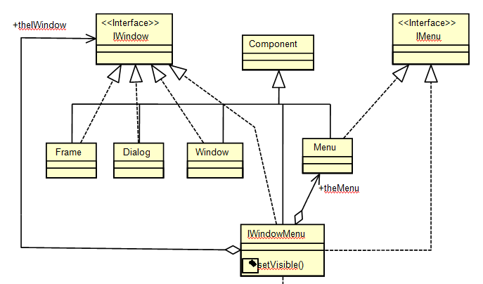
Collaborations – Solution
Module: OO Design Principles & Techniques
Copyright © Venkat Shiva Reddy – Trainer, Aug 2005

Slide 61
Question time
Please try to limit the questions to the topics discussed during the session.
Participants are encouraged to discuss other issues during the breaks.
Thank you.
Module: OO Design Principles & Techniques
Copyright © Venkat Shiva Reddy – Trainer, Aug 2005

Slide 62
Unit 3
Design Principles
Module: OO Design Principles & Techniques
Copyright © Venkat Shiva Reddy – Trainer, Aug 2005

Slide 63
Design Principles
Topics
  Interface Segregation Principle (ISP)
  Interface and Implementation separation
  Inheritance Vs Aggregation
  Mixed Role Cohesion
  Association Class
  Abstract Base Class pattern
  LISKOV Substitution Principle (LSP)
  Interfaces and packaging
  Inheritance Drivers
  Aggregation Drivers
Module: OO Design Principles & Techniques
Copyright © Venkat Shiva Reddy – Trainer, Aug 2005

Slide 64

Controlled Access to clients
Design of a Cache Interface
        An instance of the class realizing this interface is used by different types of clients
        The Cache type instances can be used for accessing information, changing the information or adding, removing, finding objects, etc. added to the Cache.
        It is important to restrict one category of clients to only one set of operations
        How do you ensure that different clients are still provided with an instance of the LoanCache but are restricted to using only limited set of operations?
<<Interface>>
ICache
getMethods()
setMethod()
add(object : Object)
remove(object : Object)
find(id : String) : Object
LoanCache
Module: OO Design Principles & Techniques
Copyright © Venkat Shiva Reddy – Trainer, Aug 2005

Slide 65
Interface Segregation Principle (ISP)
By using the principle of ISP, it is possible to expose different interfaces to different clients and still present the same instance
<<Interface>>
<<Interface>>
ICacheRead
ICacheWrite
getMethods()
setMethods()
<<Interface>>
ICache
add(object : Object)
remove(object : Object)
find(id : String) : Object
LoanCache
Module: OO Design Principles & Techniques
Copyright © Venkat Shiva Reddy – Trainer, Aug 2005

Slide 66
Understanding Interface and Implementation
Fill the table based on reuse Interface / implementation for each relationship
Relationships Interface Implementation
Generalization
Realization
Aggregation
Module: OO Design Principles & Techniques
Copyright © Venkat Shiva Reddy – Trainer, Aug 2005

Slide 67
Understanding Interface and Implementation
Generalization
  Reuse of interface and implementation
  Implementation(+ Interface) Inheritance
Realization
  Reuse of only interface
  Interface Inheritance
Aggregation
  Reuse of only implementation
  Implementation reuse and not the interface
Module: OO Design Principles & Techniques
Copyright © Venkat Shiva Reddy – Trainer, Aug 2005

Slide 68
Understanding Interface and Implementation
Relationships Interface Implementation
Generalization Y Y
Realization Y N
Aggregation N Y
Therefore, it is possible to equate
    Generalization = Aggregation + Realization
Module: OO Design Principles & Techniques
Copyright © Venkat Shiva Reddy – Trainer, Aug 2005

Slide 69
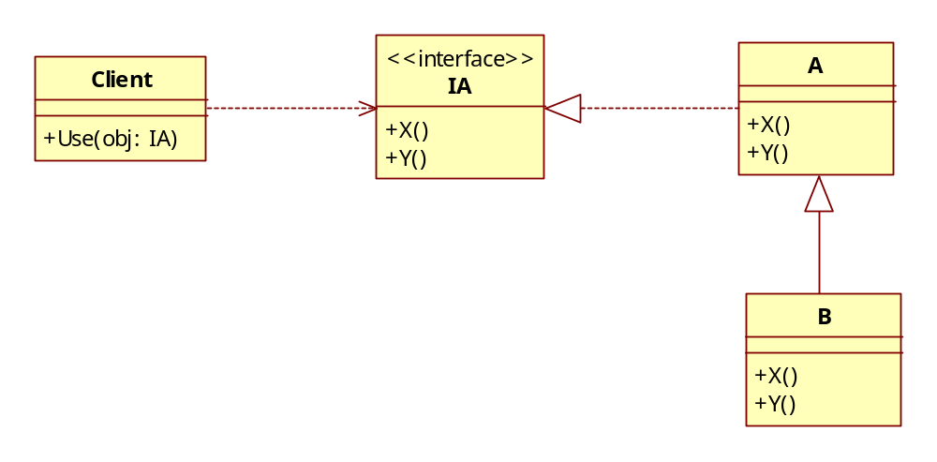
Inheritance Vs Aggregation
Class B reuses interface and implementation through Generalization
Model 1
Client
A
use(obj : IA)
x()
IA
y()
x()
y()
B
Module: OO Design Principles & Techniques
Copyright © Venkat Shiva Reddy – Trainer, Aug 2005

Slide 70
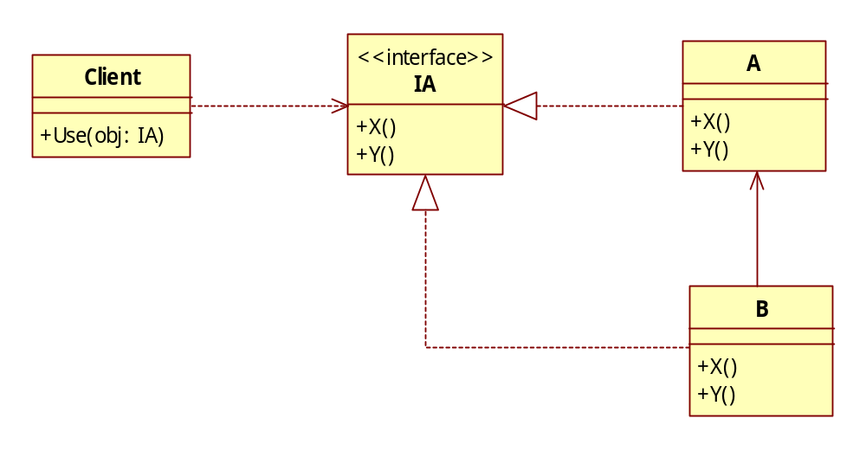
Inheritance Vs Aggregation
Class B reuses interface through Realization and reuses implementation through Aggregation
Model 2
A
Client
x()
use(obj : IA)
IA
y()
x()
y()
B
Module: OO Design Principles & Techniques
Copyright © Venkat Shiva Reddy – Trainer, Aug 2005

Slide 71
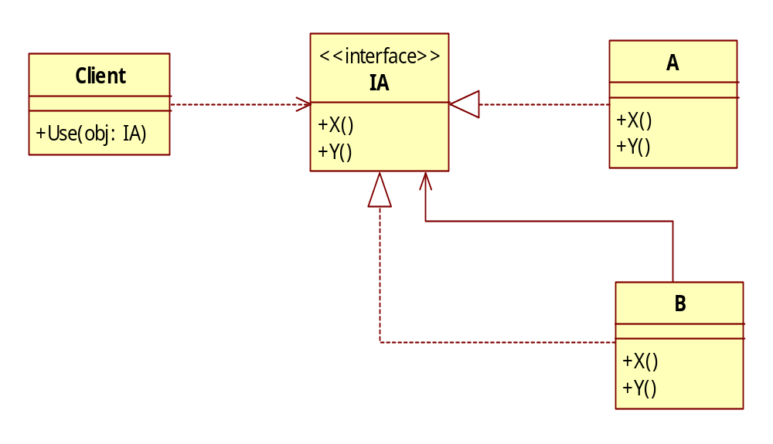
Inheritance Vs Aggregation
Class B reuses interface through Realization and reuses implementation through Aggregation
Model 3
Client
A
use(obj : IA)
x()
IA
y()
x()
y()
B
Module: OO Design Principles & Techniques
Copyright © Venkat Shiva Reddy – Trainer, Aug 2005

Slide 72
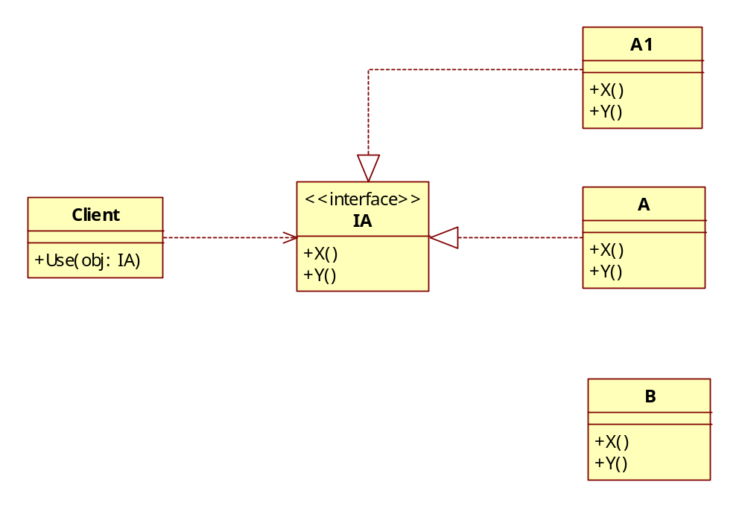
Inheritance Vs Aggregation
Discuss maintainability achieved from the previous three diagrams
What happens when B needs to reuse another class, say A1
Model 1
Client
Model 2
use(obj : IA)
IA
x()
y()
Model 3
Module: OO Design Principles & Techniques
Copyright © Venkat Shiva Reddy – Trainer, Aug 2005

Slide 73
Mixed Role Cohesion
Consider the following design
  The responsibilities of each type of employee varies
<<abstract>>
Employee
empId
name
get and set methods()
getResp()
Developer
Tester
Lead
Designer
Manager
getResp()
getResp()
getResp()
getResp()
getResp()
Module: OO Design Principles & Techniques
Copyright © Venkat Shiva Reddy – Trainer, Aug 2005

Slide 74
Mixed Role Cohesion
What happens when
  A developer becomes a Lead
  A Lead is also a Designer
Module: OO Design Principles & Techniques
Copyright © Venkat Shiva Reddy – Trainer, Aug 2005

Slide 75
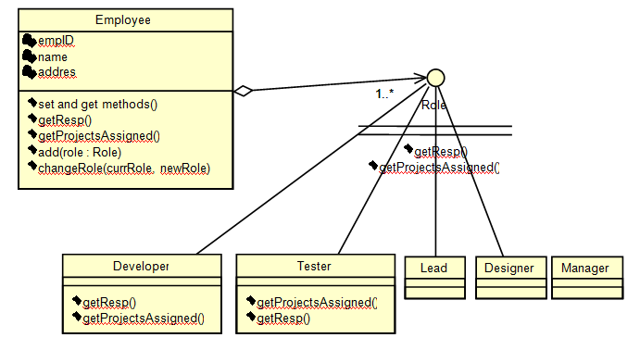
Mixed Role Cohesion - Solution
Module: OO Design Principles & Techniques
Copyright © Venkat Shiva Reddy – Trainer, Aug 2005

Slide 76
Association Class
A Member has a Card
A Member is associated with a Librarian who issues a card
A Librarian issues many cards
A Card is associated with a Member
Member
Librarian
Card
Module: OO Design Principles & Techniques
Copyright © Venkat Shiva Reddy – Trainer, Aug 2005

Slide 77
Association Class
What happens when the interdependencies of the entities participating in association change over a period of time
A member may not be associated with a librarian
A librarian object may also need to keep track of all the cards issued
Member
Card
*
*
Librarian
Module: OO Design Principles & Techniques
Copyright © Venkat Shiva Reddy – Trainer, Aug 2005

Slide 78
Exercise 2
See Exercise2.doc – Bank Application
  Design a Domain model for the same
Module: OO Design Principles & Techniques
Copyright © Venkat Shiva Reddy – Trainer, Aug 2005

Slide 79
Abstract Base Class & LSP
Discuss the account problem
  Two types
    Savings
    Current
  Common implementation of withdraw and deposit
  Variable implementation of open and close
  Data
    Account No
    Customer Name
    Balance
Module: OO Design Principles & Techniques
Copyright © Venkat Shiva Reddy – Trainer, Aug 2005

Slide 80
LSP
Liskov Substitution Principle (LSP)
  Proposed by Barbara Liskov
  ‘A class or an interface stands as a true substitute or a representative for all the sub classes in the class hierarchy’
Module: OO Design Principles & Techniques
Copyright © Venkat Shiva Reddy – Trainer, Aug 2005

Slide 81
Interfaces, Packages and design
Consider the following design
  ‘accounts’ package has all accounts-related classes
    Has a public interface IAccount
    Has a public class AccFactory
    This package is designed and developed by one team
    See listing accounts package
  ‘enctools’ package has all encryption-related classes
    Has a public interface IEncrypt
    Has a public class EncFactory
    This package is designed and developed by another team for some other application
    See listing enctools package
accounts
enctools
Module: OO Design Principles & Techniques
Copyright © Venkat Shiva Reddy – Trainer, Aug 2005

Slide 82
Accounts package
<<Interface>>
<<abstact>>
IAccount
Account
accNo : String
open()
custName : String
close()
balance : double
withdraw()
withdraw()
deposit()
deposit()
setAccNo()
accounts
getAccNo()
setAccNo()
setCustName()
getAccNo()
getCustName()
setCustName()
getBalance()
getCustName()
getBalance()
Savings
Current
AccFactory
open()
open()
create(type : int) : IAccount
close()
close()
Module: OO Design Principles & Techniques
Copyright © Venkat Shiva Reddy – Trainer, Aug 2005

Slide 83
Enctools package
EncFactory
enctools
<<Interface>>
IEncrypt
encryptData()
Symmetric
ASymmetric
Module: OO Design Principles & Techniques
Copyright © Venkat Shiva Reddy – Trainer, Aug 2005

Slide 84
Interfaces, Packages and design
How will you add a new class of Accounts known as Secured versions of Savings and Current Accounts
This enhancement is done by a different team
Ideally combine the functionality of withdraw and deposit with encrypt
These classes and the factory for creating the objects would be in the new package SecAccounts
  void withdraw(double amt)
  {
    // use savings account’s withdraw
    // use encrypt from the encryption classes that you have
  }
Module: OO Design Principles & Techniques
Copyright © Venkat Shiva Reddy – Trainer, Aug 2005

Slide 85
Inheritance Drivers
Is-a relationship
Expose the interface
Implementation (+interface) inheritance
Mixed instance cohesion
Type compatibility
LSP
Module: OO Design Principles & Techniques
Copyright © Venkat Shiva Reddy – Trainer, Aug 2005

Slide 86
Aggregation Drivers
Has-a relationship
Hide the interface
Implementation reuse
Mixed role cohesion
Controlled Multiplicity
The need to eliminate class proliferation
Module: OO Design Principles & Techniques
Copyright © Venkat Shiva Reddy – Trainer, Aug 2005

Slide 87
Question time
Please try to limit the questions to the topics discussed during the session.
Participants are encouraged to discuss other issues during the breaks.
Thank you.
Module: OO Design Principles & Techniques
Copyright © Venkat Shiva Reddy – Trainer, Aug 2005

